Slide 1
Resume Writing
Center for Career Development
Library, Room 109
www.cobleskill.edu/career
Notes:
My name is Ron Pleban and I am the Career Counselor at SUNY Cobleskill. This is our resume writing presentation.

Slide 2
What is the purpose of a resume?
TO GET AN
Notes:
So what exactly is the purpose of a resume? Many people think that the purpose of a resume is to get you a job but actually, the resume’s job is just to get you an interview.
A resume is part of a marketing campaign you create for yourself that supplements your LinkedIn profile, cover letter, E-portfolio, professional websites, and references. All these things advertise what you have to offer to entice employers to call you in for an interview. With the resume, you get one or two 8.5-by-11 inch sheets of paper to sell yourself to the employer, convince them that you’re one of the best candidates, and that you are worthy of an interview.

Slide 3
Notes:
This is actually a really funny image of some common, but simple mistakes that are often seen on resumes. In the Professional Experience section, Howard “Bada Bing” Hollis forgot a letter when listing is “Public Financial Analyst” position, listing himself as a “Pubic Financial Analyst.” He also abbreviated his other position and listed himself as an “Ass Accountant.” Take a few moments and check it out.
This was obviously created for the sake of being an example and you can get a lot out of it. Simple mistakes on your resume can negatively impact your job search so take your time when creating it.

Slide 4
#1 Resume Writing Tip
Tailor your resume to the job you are applying to
Highlight specific skills, experience and knowledge required for the job that you have
Use the resume to show how you meet the requirements using their wording
Notes:
At the Student Success Center at SUNY Cobleskill, our number one tip we have for writing a resume is to ALWAYS tailor the resume to the job description. You can do this by using the job description to identify specific skills, experiences, and knowledge you have that are required for the job and then highlighting those things on your resume. In addition to the job description, read through the company’s website and mission statement. Try to use their wording when creating your resume so it looks like a document that was created by the company.

Slide 5
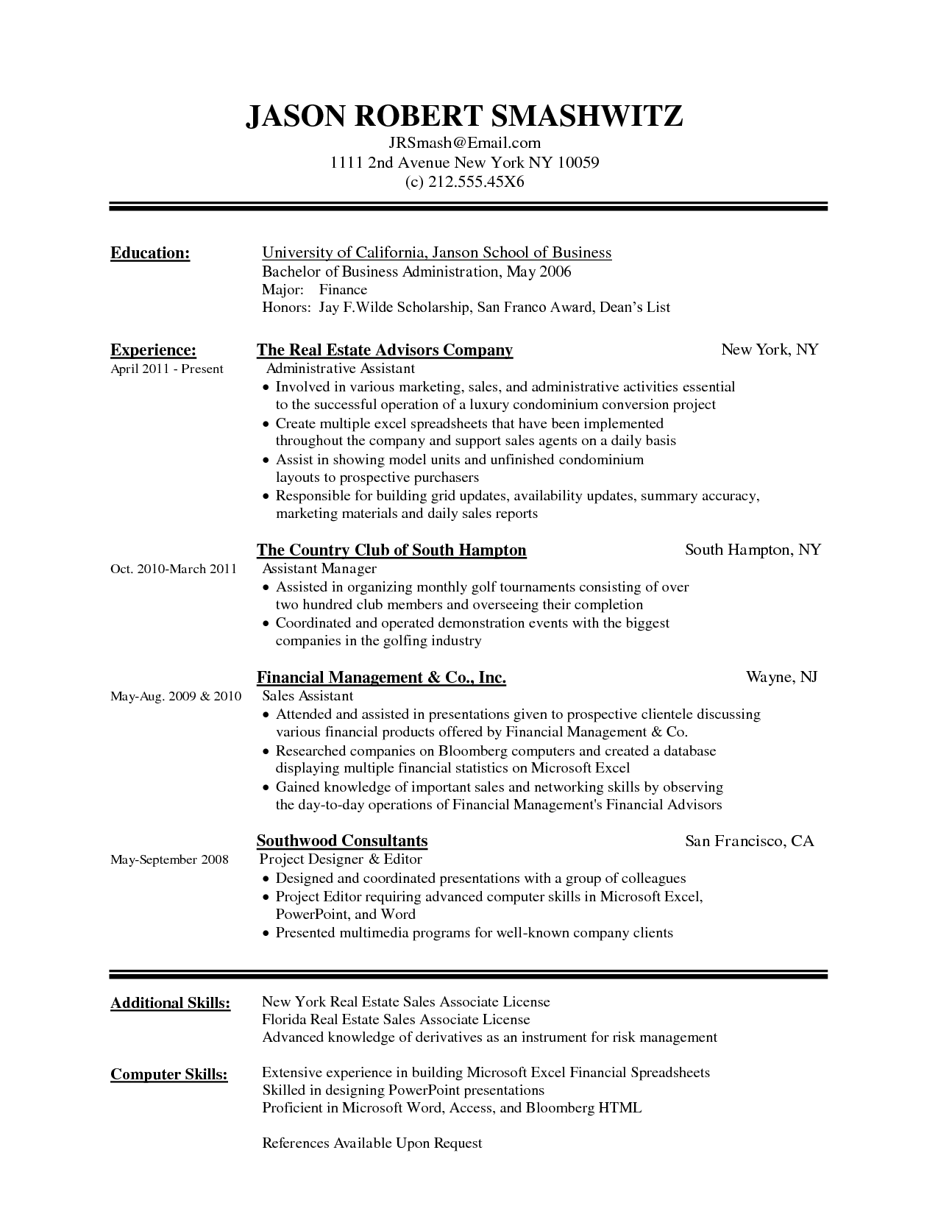
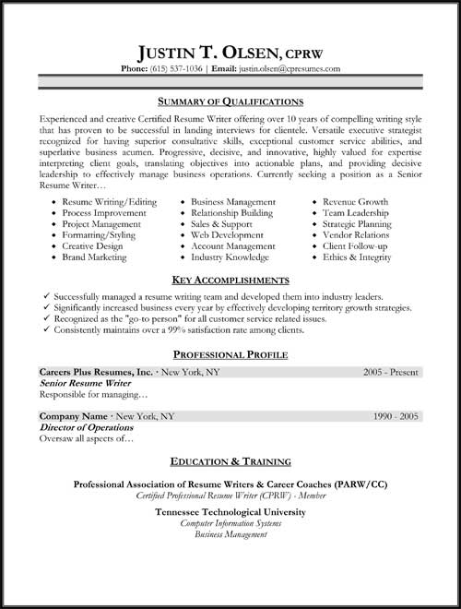
First Impressions Matter! Good Resumes
Notes:
When you meet someone, first impressions have lasting impacts on how they will perceive you. The first impression your resume makes on an employer is very important too. Your name should stand out and it should look professional and well organized.

Slide 6
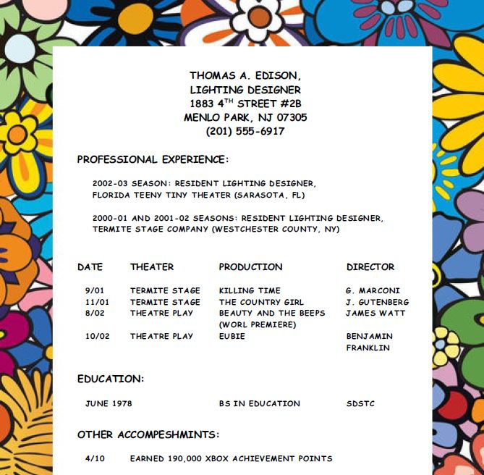
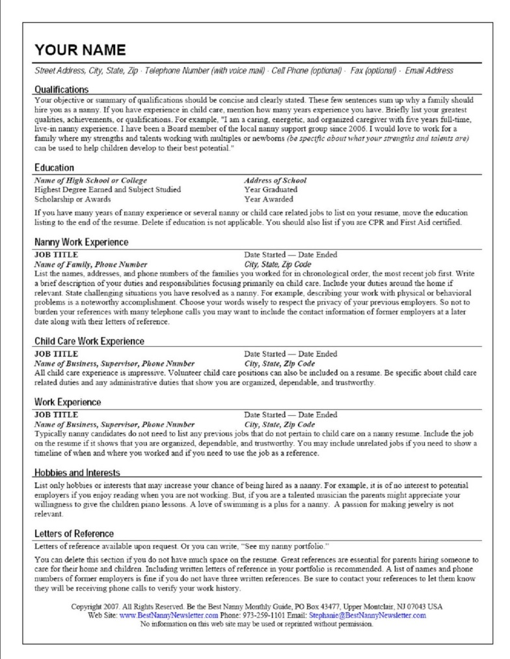
First Impressions Matter! Bad Resumes
Notes:
It shouldn’t look like an advertisement for a picnic or be so wordy that it’s hard for employers to pick out relevant information.

Slide 7
Format and Length
Formatting:
Clean and easy to read
Enough white space but not too much
Consistent font (Arial, size 11 or 12)
Length:
Typically one page for college students and recent graduates (there are exceptions)
Focus on quality and relevance of information, not on length
Notes:
When companies post positions, it’s not uncommon for there to be hundreds of applicants for one position. Taking the time to review every application in depth is not practical for employers. To make the pool of candidates more manageable, most employers have an initial screening process for resumes. In this screening process, employers will take as little as 15-20 seconds to quickly scan over every resume. They look for red flags to eliminate candidates such as excessive spelling errors, lack of professionalism, inadequate experience or education, and other things. They also look for exceptional qualities in candidates.
This is why format is so important. You want your resume to be clean and easy to read. Tailor your resume so the information the employer is looking for jumps right out to them. Make sure there is enough white space that the document is easy to read but not too much where your resume looks empty. Your resume should be a consistent font. We recommend Arial, size 11 or 12. It’ may not be very exciting but it’s effective! Do NOT use Times New Roman.
We get a lot of questions about how long a resume should be. Most college students’ and recent college graduates’ resumes will be one page. This is because they have limited relevant experience for the position they are applying to. For those with more quality and relevant experiences, their resume is more likely to be 2 pages. Just because you have enough experience to put on two pages doesn’t mean you should fill it up though. If you bury relevant experiences you have in things that the employer doesn’t care about, they might miss the information you want them to see, preventing you from getting an interview. When working on your resume, focus on the quality and relevance of your content, not how long it is.
Let’s start breaking down the rest of your resume.

Slide 8
Contact Information/Heading
Contact information:
Address (Don’t include country)
Professional Email Address
Phone #
Examples:
Ronald E. Pleban
97 Main Street, Cobleskill, NY 12043
plebanre@cobleskill.edu
(518) 255-5624
Ronald E. Pleban
plebanre@cobleskill.edu
(518) 255-5624
College Address Permanent Address
142 Schenectady Avenue, Bouck Hall Box 1234 97 Main Street
Cobleskill, NY 12043 Cobleskill, NY 12043
___________________________________________________________________________________________________________________________
___________________________________________________________________________________________________________________________
Notes:
Your heading includes your contact information. Your name should be bigger than everything else and bolded. You should include your address, email address and phone number in the title. Make sure that your email address is professional. You can use First Name Last Name or Last name and some numbers but don’t use something complex or inappropriate. Don’t include the country unless you are applying to a position in a different country. Displayed here are two examples of headings - One lists a permanent address and the other lists both the permanent and the college address. If you are only listing one, center the heading. If you are including two addresses, one way to display the information is to center everything but your addresses and then put one on the right and the other on the left.

Slide 9
Objective Statement…
Notes:
Traditionally, the next thing on a resume was an objective statement that talked about your goals. This is no longer practiced and is a waste of valuable space on your resume. You can talk about your goals and aspirations in your cover letter and save the space on your resume for relevant and quality information that employers are looking for.

Slide 10
Summary of Qualifications
Use brief, bulleted summary to make it easy for the employer to see you meet their requirements
Example for a Culinary related position:
Four years of hands-on culinary experience including line-level and management experience
Knowledgeable of pairing wine with meals
Experienced in creating menu choices
Intermediate abilities in Spanish Language
This is a great place to list TRANSFERABLE SKILLS
Notes:
We mentioned before that our number one tip is to tailor your resume to the position you are applying for. One excellent way to do this is by starting your resume off with a Summary of Qualifications section. This could also be named “Related Skills” or Professional Highlights. You can even name it something like “Highlights for XYZ Company’s Manager Position” to clearly show the employer you took time to write the resume for them.
Use bullet points to briefly summarize the skills, qualifications, and knowledge you have in addition to any outstanding achievements the employer would want to know about. This is also a great place to talk about transferable skills if you have limited experience in the field. Transferable skills are abilities you have developed in one job which can be transferred to another, unrelated position. For example, let’s say you were a server at a restaurant while you were in college and you were applying to a position as an Assistant Office Manager. Even if you have never worked in an office the customer service, communication, and time management skills needed in order to be a successful server would be very helpful in being an effective assistant manager. These can be great skills to highlight

Slide 11
Education
Don’t include High School Information
Include the full name of the college and the degree
If you already have associate degree from SUNY Cobleskill and are working on your bachelors degree, You don’t need to write the name of the college twice
When listing your graduation date, write out the Month and Year. If you haven’t finished the degree, indicate when it will completed
You can add your GPA if over a 3.0
Examples:
State University of New York at Cobleskill, Cobleskill, NY
Bachelor of Technology, Animal Science
Anticipated May 2018, Current GPA 3.2
Associate in Applied Science, Animal Science
May 2016, GPA: 3.41
State University of New York at Cobleskill, Cobleskill, NY
Bachelor of Technology, Agricultural Business Management
Anticipated May 2019, GPA 3.1
_____________________________________________________________________________
Notes:
When making your resume, you want to list the most important and impressive information for the employer first. For most college students and recent grads, the next section on your resume will likely be the Education section. As you gain more professional experience, your education will probably move it’s way towards the bottom of your resume because your professional experiences will speak more about your abilities than your education. For now, your education might be your best asset.
When listing your education, write out the full name of your college. Instead of writing SUNY Cobleskill, actually write out State University of New York at Cobleskill in Cobleskill, NY. Below that, Write out the full name of your degree. In this example, you’ll see we wrote out Bachelor of Technology in Animal Science. If you’re not sure exactly how to write out your degree, look it up. After that, write your graduation date or Anticipated Graduation date if you are working on the degree still. You can also add your GPA if it’s a 3.0 or higher.
If you have multiple degrees, write them in chronological order with the most recent or current degree first. If the degrees are from the same institution, you don’t have to write the college out twice.

Slide 12
Relevant Courses
Great if you have limited experience or are applying to a job in a specialized field
Use a table with columns to save space
Try not to list more than 6-8 courses (There are exceptions)
Don’t list the course number
NOTE: If you have relative experience, it is probably more valuable to an employer than classes.
Notes:
If you have limited experience or are entering a very specialized field, the next section of your resume might be “Relevant Courses or Coursework.” This will highlight show employers you have some knowledge in the field. We recommend using a table with two columns to list your coursework and that you don’t list more than 6 or 8 classes. It’s important to note that once you have experience, it is typically more valuable than the coursework.

Slide 13
Experiences
List all experience in chronological order, most recent to oldest
Use bullets starting with action statements to sell your skills, accomplishments, results and purpose
Utilized interpersonal skills to provide excellent customer service
Developed problem-solving, multi-tasking and time management skills to effectively perform duties
Quantify when possible
BEFORE: Answer questions, recommend appropriate merchandise and process sales
AFTER: Service 45-60 customers per shift by answering questions, recommending appropriate merchandise and processing sales using a cash register in order to consistently meet and surpass daily sales goal of $500.
Prioritize your bullets. List most important points first
It is NEVER ok to write “Me,” “My,” or “I”
Always write action statements in the correct tense
Notes:
The Experience Section of your resume is one of the most important and difficult sections of the resume to build. To describe your work, use bullets to write strong action statements to show what your job responsibilities were/are and sell your skills, accomplishments, results and purpose. You might have utilized interpersonal skills to provide excellent customer service to over 25 tables per shift or developed problem-solving, multi-tasking and time management skills to effectively perform duties.
Whenever possible, quantify your examples though. For example, a student I worked with once wrote that he answered questions, recommended appropriate merchandise and processed sales. To an employer, that is very vague. By giving a little more information, you can paint a great picture for the employer. Let’s change that statement to Service 45-60 customers per shift by answering questions, recommending appropriate merchandise and processing sales using a cash register in order to consistently meet and surpass daily sales goal of $500. That’s powerful and leaves a lot of information.
Make sure your prioritize your bullet points and put the most relevant job responsibilities first. Also, never write I, me, or my anywhere on your resume.
One last thing before I show you some examples of experience sections. Make sure you write the job descriptions in the correct tense. If you are describing a position you currently work, write it in present tense. If it’s a previous position, write it in past tense.

Slide 14
Example:
Heading Sections
Content Sections
Notes:
Here is an example of an experience section of a resume. Notice that there is a consistent format with all of the information. Each position has it’s own little heading and content section. The Job Title is is the upper left, the dates of employment are written in the upper right, the Company or Employer are on the bottom left, and the City and State are on the bottom right. Below that, bullet points list all the information about the position. This repeats for all of the positions. Also, notice that the positions she is currently working are written in present tense. “Collaborate with, Monitor, Practice…” The Farm hand position she used to work is written in past tense. “Developed, Communicated, and Maintained”

Slide 15
Example:
Notes:
If you have relevant experience but have worked other positions more recently, it’s ok to split your experience section up. You can call one Related or Relevant Experience and the other Work or Employment history, Just like in this example. List your relevant experience above the other experiences. The unrelated experience can still be helpful for an employer to know about, especially if you worked there for a few years. This can show that you are a good employee and can hold a job. It can also let employers look for transferrable skills that you might not have though of.

Slide 16
Other Sections to Consider
Activities
Participation in clubs, sports, orchestra, or other organizations
Leadership Experience
Volunteer Work
Certifications/Licenses
Example: Servsafe, CDL, or Forklift Certification
Honors
Dean’s list, special honors, awards or scholarships
On-the–job Recognition
Employee of the Month, Customer Service Award
Notes:
Resumes are unique documents and there could be an assortment of other sections you might want to consider adding. These include but aren’t limited to Activities, Leadership Experience, Volunteer Work, Certifications/Licenses, Honors, and on-the–job Recognition.
When listing activities, you might want to think about club participation, sports, and especially academic related activities. Being a student athlete or part of a orchestra can say a lot to an employer about your dedication and teamwork abilities. Under leadership experiences, think about leadership roles you held in clubs or on teams. You can also list leadership conferences or awards you received.
Volunteer Work is a great section to list if you have experience. Showing your commitment to the community can really impress employers.
Certifications/Licenses, Honors and On-the–job Recognitions can be listed too. Just make sure you stay grounded and list relevant honors. Your friends may be impressed if you completed all the T-shirt challenges at the local bars or hold the record for the most chicken wings consumed on wing night, but these are the honors employers are looking for. It’s ok to list scholarships that you competed for or were nominated for. Don’t list need based scholarships or grants though.

Slide 17
Resume Examples
Notes:
And here you have it. Two different resume formats. Both are well organized and information is easy to grab. The exact format you choose to use isn’t as important as the quality of the content. We have a resume program at SUNY Cobleskill called Optimal Resume that produces the resume on the left. The program is very easy to use and has a great feature where you can submit resumes and cover letters to be reviewed by professionals. Check out the optimal resume presentation to learn how to create an account and get started.

Slide 18
Additional Tips
PROOF READ,
PROOF READ,
PROOF READ!
Notes:
I am going to wrap this up but before we leave, I have a few more resume tips for you. The first one is to proof read it, then give it to a friend to proof read it, then proof read it again. You cannot have too many eyes review your resume. I showed you the resume blunders in the beginning of the presentation. Avoid submitting your resume with simple mistakes by taking the time to proof read it thoroughly. Spell check is not enough.

Slide 19
Additional Tips
PROOF READ, PROOF READ, PROOF READ!
Use resume buzzwords
Cover letter, resume and list of references should all be the same font
Use quality resume paper if submitting hard copy
When emailing a resume, send all documents as a PDF
Double check to make sure you have selected the right resume/cover letter before you send it
Notes:
Look up and use resume buzzwords. These are powerful words like Incorporated, Achieved, Balanced, and Managed that show that you have accomplished things. Make sure your Resume, cover letter and references are in consistent fonts and all have your name on them. If you write the best resume in the world but forget your name, you’re not getting the interview! If you are submitting a hard copy, use good quality paper that is all the same color, either cream or white. You can get some here at the Student Success Center. When emailing these documents, make sure you save them as a PDF documents so that way the format is correct when the employer gets the file.
This seems very simple but make sure you are attaching the right documents to the email when you send your resume and cover letter. You might be able to get away sending the wrong resume but you definitely don’t want to send a cover letter addressed to the wrong person out.

Slide 20
Additional Tips
Use caution when using answering interview call on a cell phone
Have an appropriate voice mail message
Clean-up all social networking sites
Don’t wait until last minute when you are stressed to submit a resume by a deadline
Take breaks if you get frustrated
USE THE STUDENT SUCCESS CENTER!!!!
Meet one-on-one with Career Counselor
Work with student interns
Notes:
Use caution when answering interview calls on your cell phone. Basically, just make sure you are in a location you wont get interrupted with good cell service. If you are checking out at the grocery store, your phone rings and you think it might be an employer calling to set up an interview. Let it go to voicemail and call them back when you are in a good spot. This wont be a problem because you have already made sure your voicemail message is appropriate, right?
Make sure you clean up your social media websites and take down inappropriate and controversial content or photographs. When working on your resume, take breaks when you are frustrated. It helps if you don’t wait until last minute when you are really stressed to get an application in.
Finally, utilize the Student Success Center. We are here to help both while you are in school and after you graduate. You can come meet one on one with a career counselor, Work with student assistants, or just come to get a few tips here and there.

Slide 21
Come See us at the Student Success Center!
Library, Room 109
www.cobleskill.edu/ssc
Open:
Monday – Friday
8:00 AM – 4:15 PM
Notes:
Thank you very much and if you have any questions, you know where to find us.

